Slide 1



PREDICTING THE RATING OF A MOVIE
THE MOVIES
PROJECT 4 – TEAM 4
OCTOBER 2022
Notes:
CLAUDIA
Movie 12 seconds

Slide 2




Script
INTRODUCTION
The Movie world and why we build the model
Visualising the problem
ETL & PROCESS
Workflow
PREDICTION MODEL BUILD
Random Forest / one-hot encoding
PREDICTION MODEL DEPLOYMENT AND DEMO
Solving the problem
SUMMARY
Key Findings and lessons learned
Notes:
CLAUDIA – 34 Seconds
We are going to discuss the theme selected, how we developed the process and the model, showing a demo of the final product and a brief summary of the key findings.

Slide 3
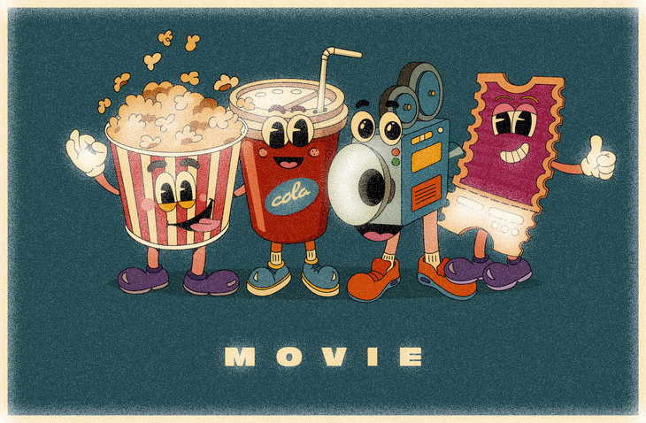
Team
CLAUDIA SANDOVAL
JULIA COOPER
CHRIS MAI
DAT NGUYEN
Notes:
CLAUDIA – 34 Seconds
This is our team who will be presenting.
I will explain the background of the field we choose, a brief summary of the environment and the problem we found when analysing the data, an the introduction of the solution
Julia will talk about the process we went through
Chris will discuss the building of the model
And Dat will show the model and a demo
Finally, Julia will be summarising the key findings and lessons learned.

Slide 4
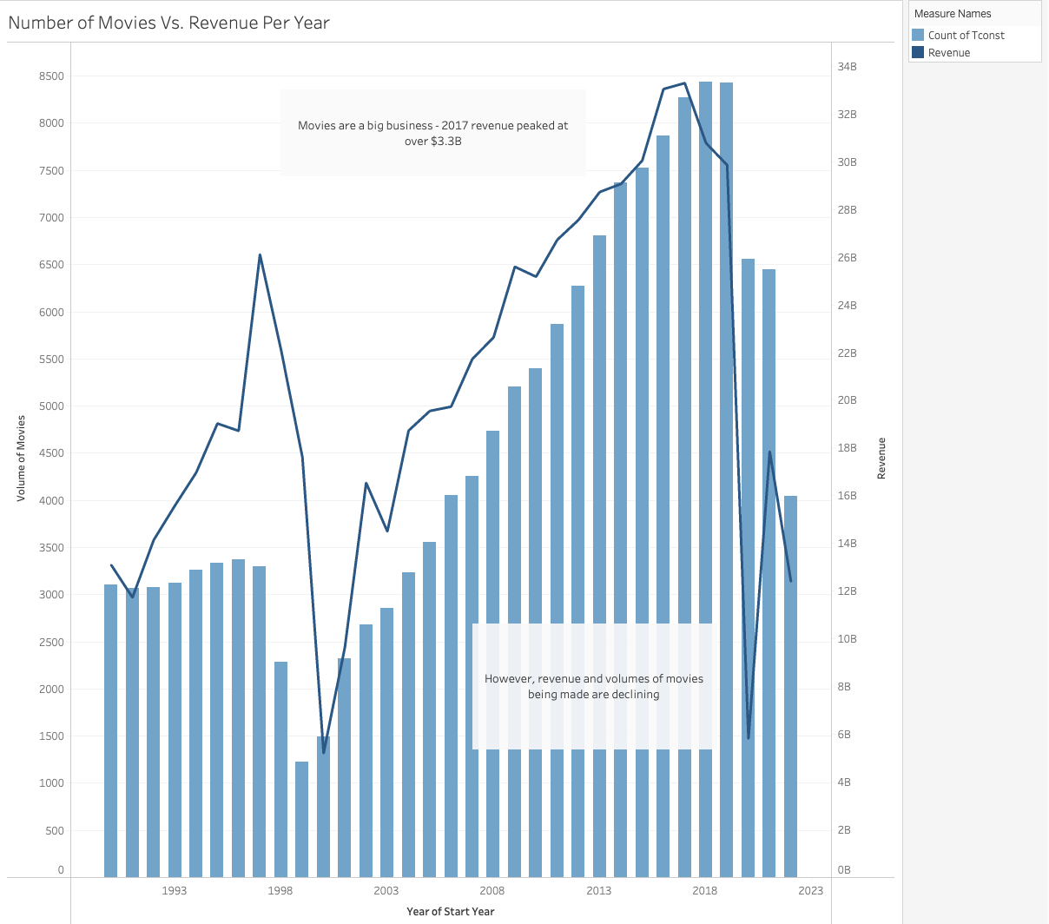
INTRODUCTION
The Movie World – Defining the problem
Movie industry:
High investments / High risks
Overall numbers and revenue are declining
Notes:
CLAUDIA – 34 Seconds
The Movie Industry involves the increasing investment of money in a high risk environment.
There are different perceptions of success for a movie project and many influencing factors.
Movie ratings are derived from a wide range of outputs and are an strong independent indicator of success.
Industry is becoming increasingly competitive, especially with the incorporation of the streaming services
---------------------------
Measures of success
There are different perceptions of success for a movie project and many influencing factors.
Movie ratings are derived from a wide range of outputs and are an strong independent indicator of success.
---------------------------
The model is a B2B product
The target market we are aiming is Business companies in the movie industry
Medium and small production companies (independent movies)
---------------------------
To reduce some of the risk we propose to develop a model which will predict the rating of a movie based on a defined set of features
Our model us built in the premise of knowing the inputs that will optimise your output will increase the chances of success.
The model will help to accurate rate the movie to predict success / not success before the movie is released

Slide 5
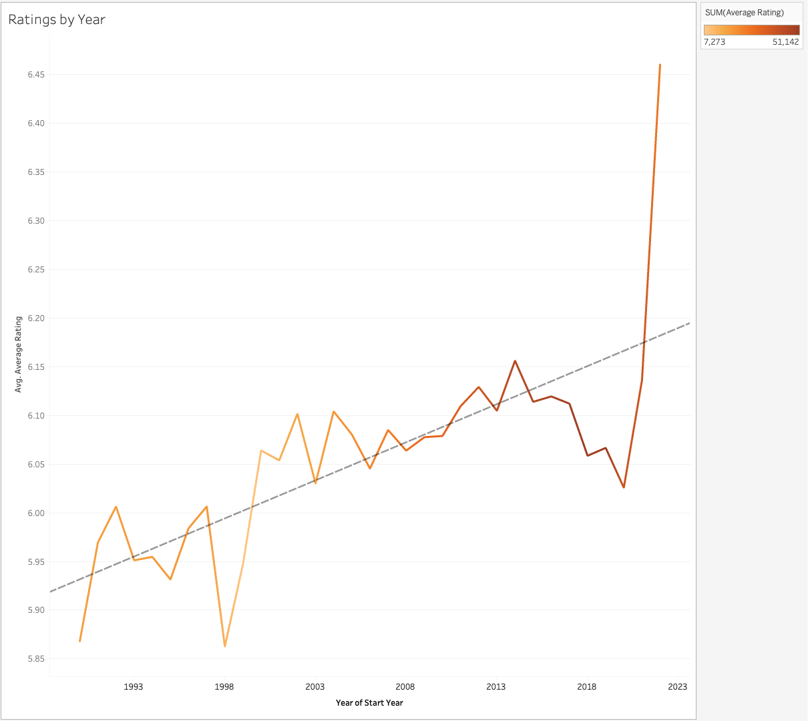
INTRODUCTION
Measures of Success
Movie ratings come from a wide range of features
Trending up with a harp increase in 2022
Notes:
CLAUDIA – 34 Seconds
The Movie Industry involves the increasing investment of money in a high risk environment.
There are different perceptions of success for a movie project and many influencing factors.
Movie ratings are derived from a wide range of outputs and are an strong independent indicator of success.
Industry is becoming increasingly competitive, especially with the incorporation of the streaming services
---------------------------
Measures of success
There are different perceptions of success for a movie project and many influencing factors.
Movie ratings are derived from a wide range of outputs and are an strong independent indicator of success.
---------------------------
The model is a B2B product
The target market we are aiming is Business companies in the movie industry
Medium and small production companies (independent movies)
---------------------------
To reduce some of the risk we propose to develop a model which will predict the rating of a movie based on a defined set of features
Our model us built in the premise of knowing the inputs that will optimise your output will increase the chances of success.
The model will help to accurate rate the movie to predict success / not success before the movie is released

Slide 6
INTRODUCTION
B2B Product
Business Companies & Independent Production Companies
The Predicting Model – The solution
Model that predicts rating of a movie based on a range of features
Present in three parts:
ETL
Model Build
Model Deployment
Notes:
CLAUDIA – 34 Seconds
The Movie Industry involves the increasing investment of money in a high risk environment.
There are different perceptions of success for a movie project and many influencing factors.
Movie ratings are derived from a wide range of outputs and are an strong independent indicator of success.
Industry is becoming increasingly competitive, especially with the incorporation of the streaming services
---------------------------
Measures of success
There are different perceptions of success for a movie project and many influencing factors.
Movie ratings are derived from a wide range of outputs and are an strong independent indicator of success.
---------------------------
The model is a B2B product
The target market we are aiming is Business companies in the movie industry
Medium and small production companies (independent movies)
---------------------------
To reduce some of the risk we propose to develop a model which will predict the rating of a movie based on a defined set of features
Our model us built in the premise of knowing the inputs that will optimise your output will increase the chances of success.
The model will help to accurate rate the movie to predict success / not success before the movie is released

Slide 7


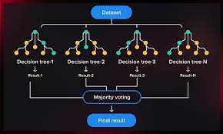


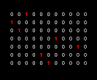








PROCESS
Predicting
Model
CSV
TSV
JSON
ML
TABLEAU
DATA
FRAMES
Deployment
Exploration and
Visualisation
Query
data
API
Notes:
JULIA

Slide 8
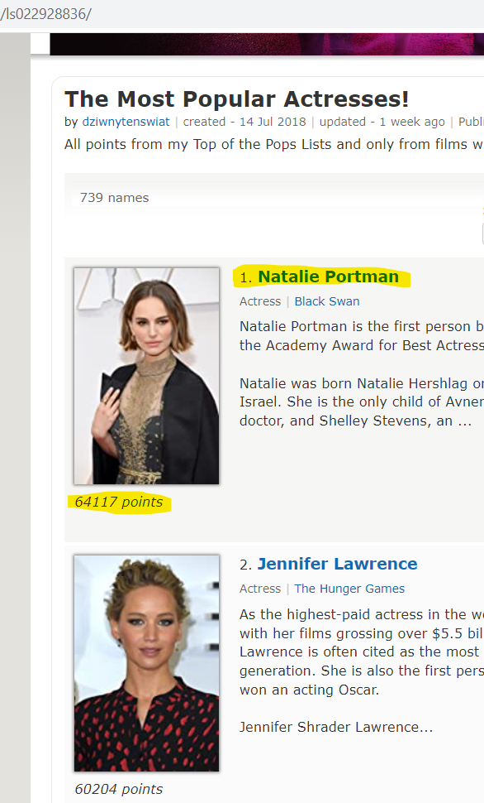
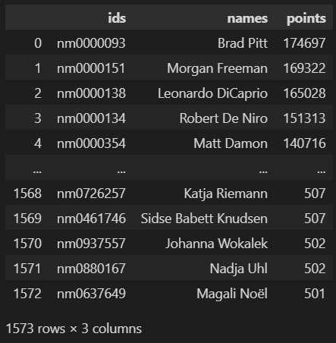
DATA EXTRACTION VIA WEB SCRAPING
1573 actors
https://www.imdb.com/list/ls022928836/
https://www.imdb.com/list/ls022928819
Notes:
JULIA

Slide 9
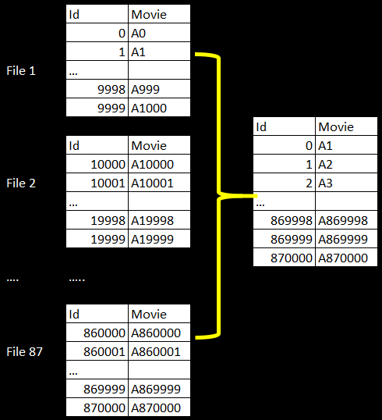
DATA EXTRACTION VIA API
Key points
Data not available at one source
At the movie level
XX csv’s, xx notebook over 3 days
>870,000 Movies 1990 - 2022
Data Sources
Three main data sources were used:
OMDB API - https://www.omdbapi.com/
MOVIE DB API - https://www.themoviedb.org/
IMDb API - https://www.imdb.com/
Web scraping actor and actress details
Notes:
JULIA

Slide 10
DATA TRANSFORMATION & LOADING
pandas
Import 102 files
Convert to df
Cleaning and joining
Dropping values
First iteration of groupings
Exporting to a suite of CSV file
Multiple properties, methods and functions
Iterative process
Ongoing refinement
New data fields
Exploration
Background analysis:
>153K movies 1990-2022
>100 features
Notes:
JULIA

Slide 11
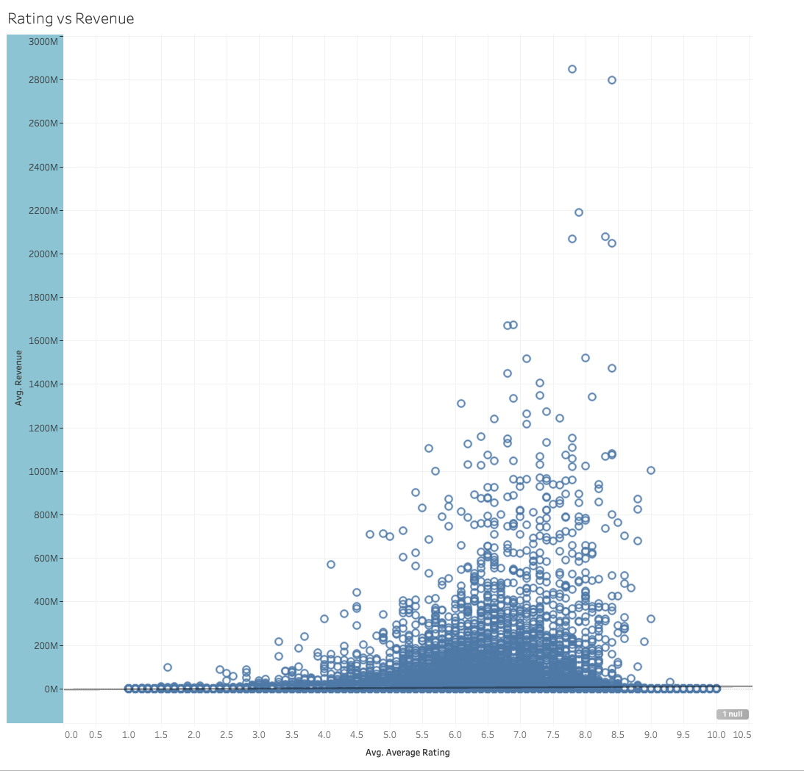
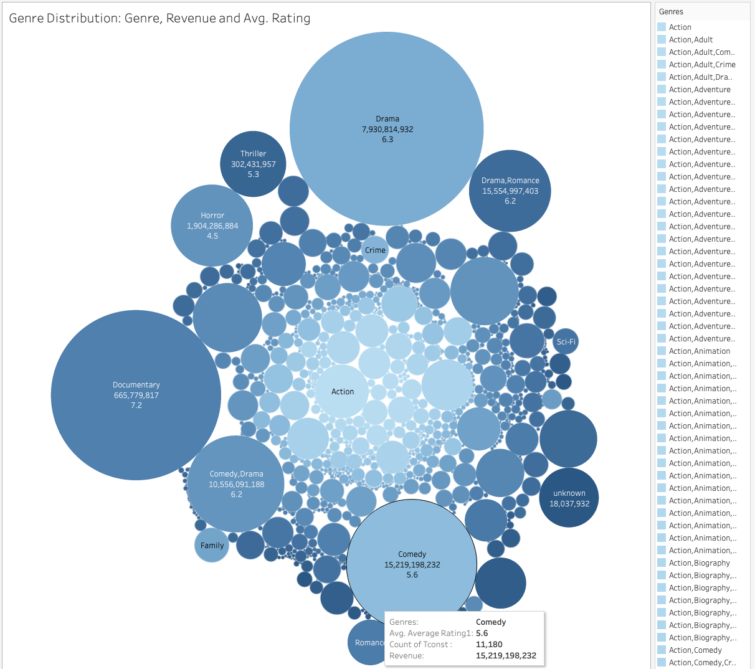
Using insights to design model
Correlations were not found looking at single features and other features on their own showed wide distribution
1035 Genre combinations
Revenue vs. ratings
Genre by volume & ratings
Notes:
CLAUDIA – 34 Seconds
These 2 graphics show a wide distribution of the information but we were unable to take this isolated features as a measure of success
Seeing this features in isolation will give us a misleading (biased) reading
We discovered that the model needs to take into account and analyse multiple features to reveal an accurate prediction and this is what the model does

Slide 12




Validation of model inputs
10 top revenue-earning movies:
Included ‘action’ in a mixed Genre
All rated PG-13
US-based production company
Part of a collection
Released in multiple languages
Included A-lister actors
Released in NH Summer or Christmas
Model: >42K movies 2017-2022
45 features
Notes:
JULIA

Slide 13
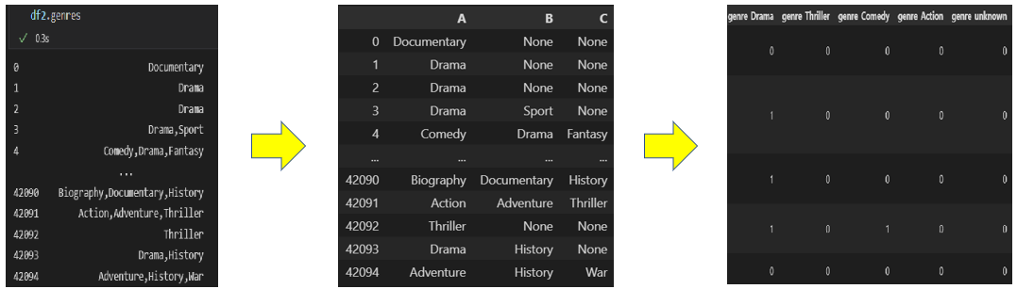
MODEL BUILD
One object
multiple
columns
One object
PER
column
One-hot
encoding
Notes:
CHRIS

Slide 14
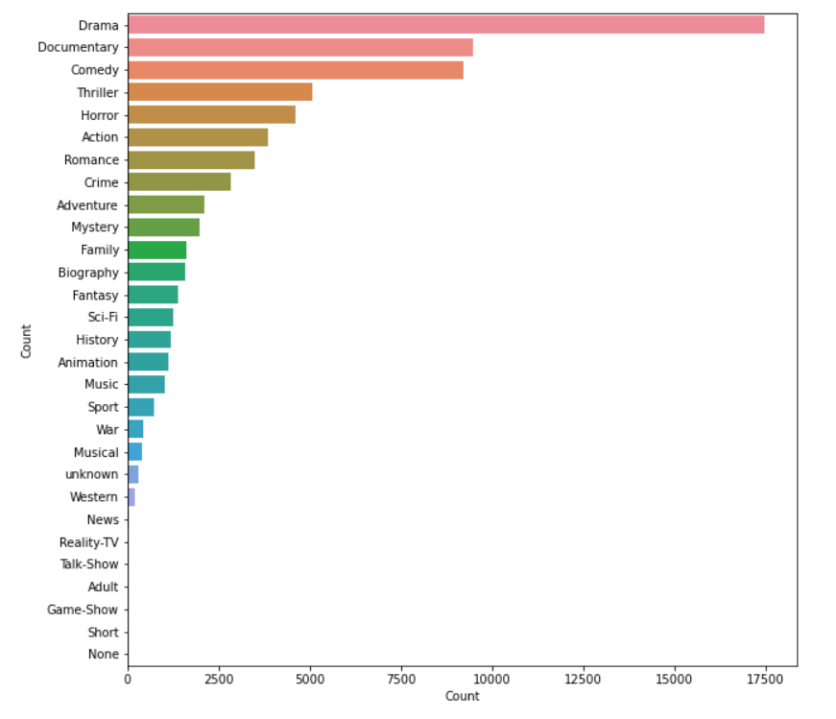
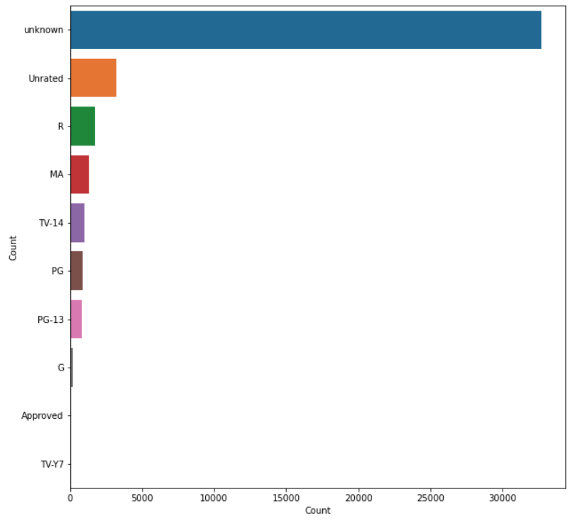
MODEL BUILD
Distribution of
Movies by genre
Distribution of
Movies by rated
Notes:
CHRIS
Matplotlib

Slide 15
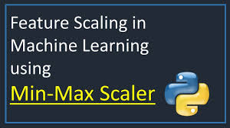
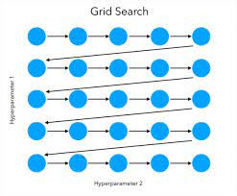
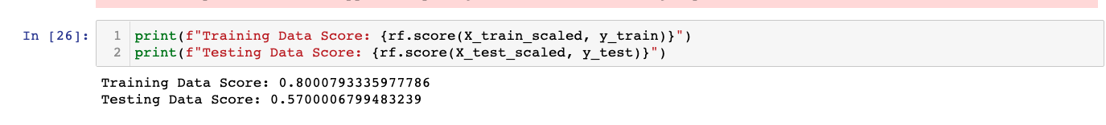
NEXT GEN DATA TRANSFORMATION
Avg rating sorted to 5 Bins
Train – Test – Split
Normalise the Train and Test data
MinMaxScaler
Grid search
GridSearchCV
Random Forest Model
Export the model
Joblib
Notes:
CHRIS

Slide 16
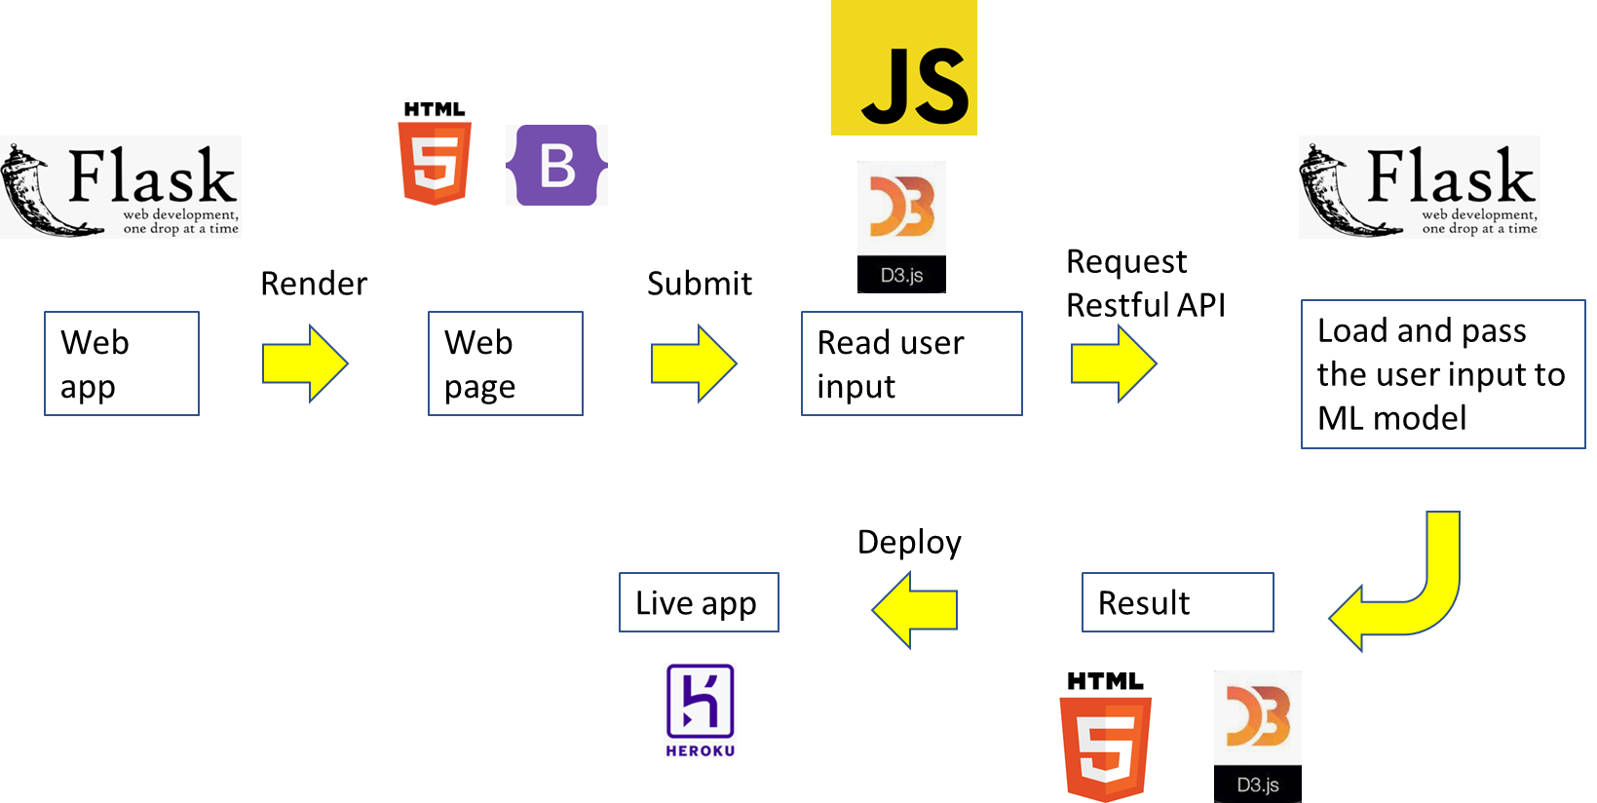
PREDICTION MODEL
Notes:
DAT

Slide 17
MOVIE PREDICTION MODEL DEMO
Live with model / Dat in control
Notes:
DAT

Slide 18
SUMMARY
Key Findings
Genres preferences have evolved:
Single features do not correlate with ratings - a set of features is required to predict the rating of a movie project as a proxy for its success.
Lessons Learned
Clear documentation is a must for any project (saves time)
Data sourcing and wrangling > 80% of the time
Benefits
Increase in the return of Investment
Reduction of risks involved in the release of a movie
Notes:
JULIA

Slide 19

Notes:
CLAUDIA
10 seconds

